Slide 1


FINANCIAL REPORTING & NARRATIVE

Slide 2

Module Agenda
Intro to Financial reporting with GenAI
Report Template
Practical Project 1: Financial Report Generation with GenAI
Practice Opportunity
© All rights reserved for Dr. Ryan Ahmed @Stemplicity Inc.

Slide 3
INTRODUCTION TO FINANCIAL REPORTING

Slide 4
Financial Planning and Analysis
Data Wrangling & Analysis: Automate reconciliation and analysis of financial data.
Competitor Analysis: Analyze competitors' financials and strategic positioning.
Anomaly Detection: Identify errors in financial transactions with AI.
Time Series Forecasting: Predict financial performance using historical data and market trends.
Variance Analysis: Analyze actuals vs. budgets to pinpoint variances and corrective actions.
Scenario Planning: Model scenarios to evaluate business decisions' financial impacts.
Financial Narratives: Generate AI-driven insights for clear stakeholder communication.
Cost Optimization: Identify inefficiencies and recommend cost-saving measures.
Data Visualization: Visualize financial data for strategic decision making
Financial Prediction Using ML Regression: Predict financial metrics such as revenues& expenses.
Financial Planning and Analysis (FP&A) is a critical business function that focuses on providing financial insights to support decision-making and drive a company’s strategic objectives.
It involves analyzing financial data, forecasting future financial performance, budgeting, and offering recommendations to enhance financial health and operational efficiency.
© All rights reserved for Dr. Ryan Ahmed @Stemplicity Inc.

Slide 5

Introduction to Financial Reporting
Financial Reporting using Generative AI refers to the application of generative AI models to automate, enhance, and streamline the creation and analysis of financial reports.
These AI models can generate text, summaries, and insights from financial data, helping businesses produce more efficient financial documents such as business quarterly performance summaries, balance sheets, income statements, and cash flow reports.
© All rights reserved for Dr. Ryan Ahmed @Stemplicity Inc.

Slide 6
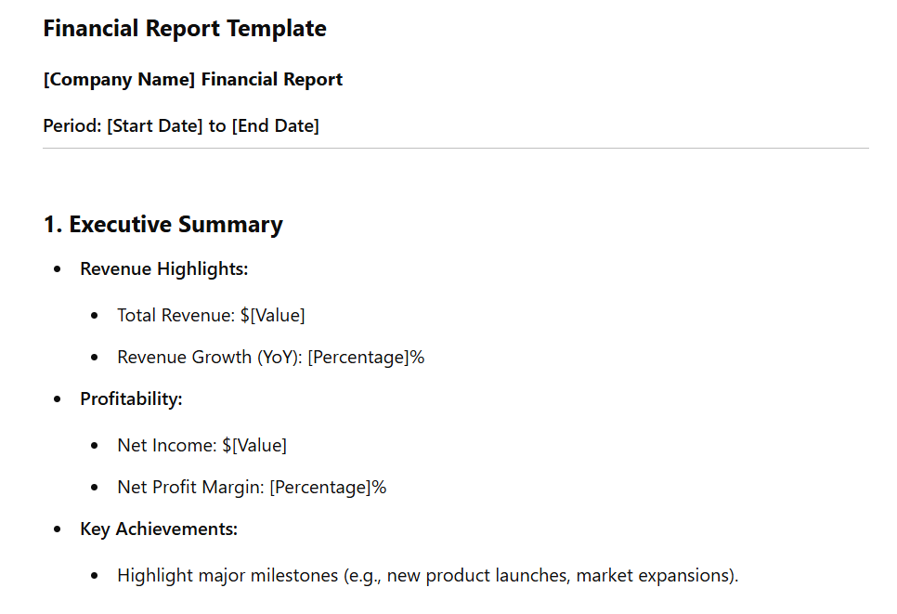
Sample Financial Report
© All rights reserved for Dr. Ryan Ahmed @Stemplicity Inc.

Slide 7
PRACTICAL PROJECT: REPORT GENERATION WITH GENAI

Slide 8
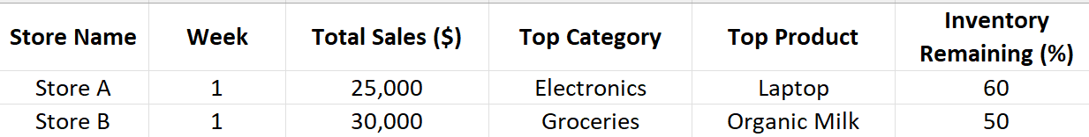
Problem Statement
The goal is to leverage generative AI to create consistent reports based on a given template.
The data and expected report output are as shown below.
Input
Data
Week 1 Sales Summary
Store Sales: Total $55,000.00 during Week 1, $25,000.00 generated from Store A, $30,000.00 generated from Store B.
Top Categories and Products:
Top Performing category is Electronics in Store A and Groceries in Store B.
Top performing product is Laptop in Store A and Organic Milk in Store B.
Inventory Levels:
Inventory for Store A is 60.0%.
Inventory for Store B is 50.0%.
Action Items:
Consider boosting stock for top-performing products like Laptop and Organic Milk.
Monitor inventory levels in Store B to ensure availability for popular items in Groceries.
© All rights reserved for Dr. Ryan Ahmed @Stemplicity Inc.
Output
Report

Slide 9
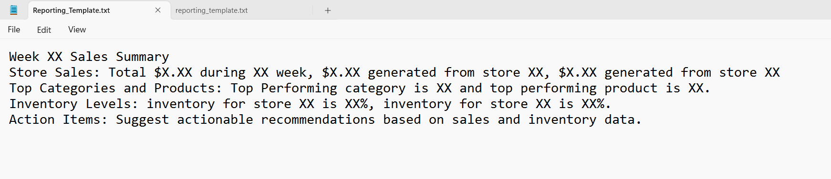
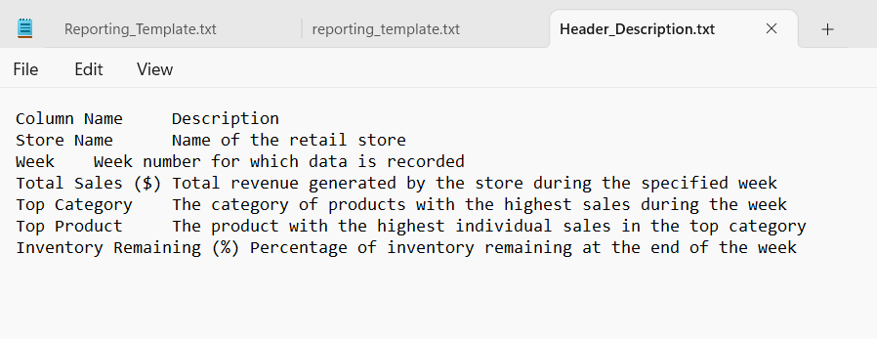
Report Template and Column Headers
Report Template
© All rights reserved for Dr. Ryan Ahmed @Stemplicity Inc.
Column Headers

Slide 10
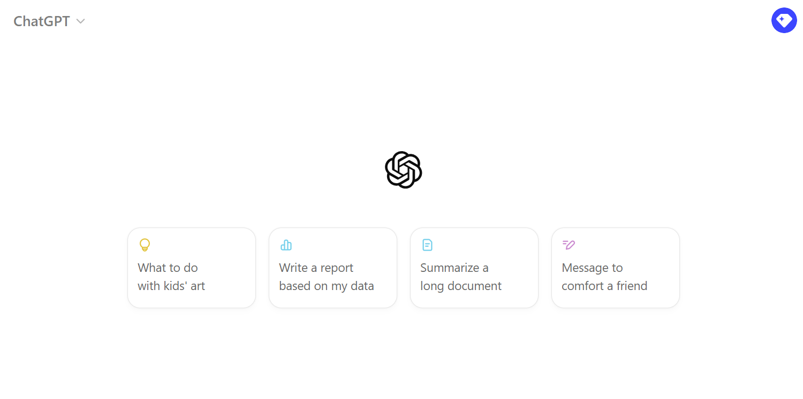
Practical Project
🔗 Click here to explore ChatGPT ChatGPT Signup
💡 Click here for AI Prompts Explore Prompts
© All rights reserved for Dr. Ryan Ahmed @Stemplicity Inc.

Slide 11
PRACTICE OPPORTUNITY

Slide 12

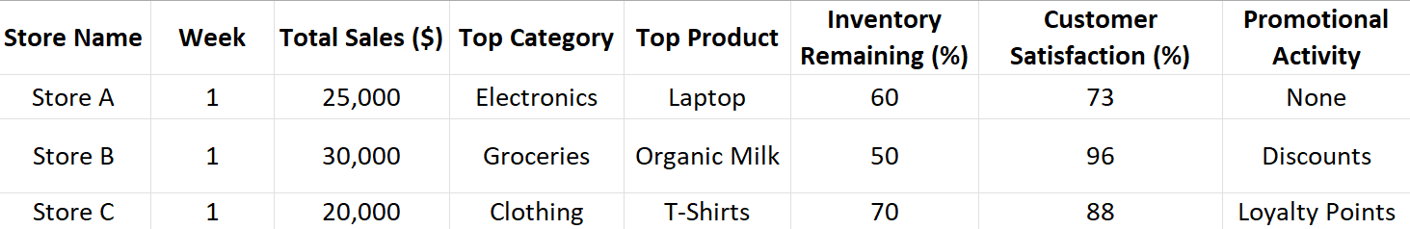
Practice Opportunity
Objective: Use generative AI to automate consistent, high-quality report generation based on updated templates.
Tasks:
Redesign Template: Update the report template to include new data columns and improve readability.
Update Column Descriptions: Revise the header description file to match the updated template.
Write Prompts: Develop a clear system and user prompts for report generation.
Test GPT Integration: Generate sample reports to validate accuracy, consistency, and alignment with the new template.
© All rights reserved for Dr. Ryan Ahmed @Stemplicity Inc.

Slide 13
Practice Opportunity Solutions
🔗 Click here to explore ChatGPT ChatGPT Signup
💡 Click here for AI Prompts Explore Prompts
💡 Click here for Practice Opportunities Solution Explore Prompts
© All rights reserved for Dr. Ryan Ahmed @Stemplicity Inc.

Slide 14
Thank you!

